Slide 1

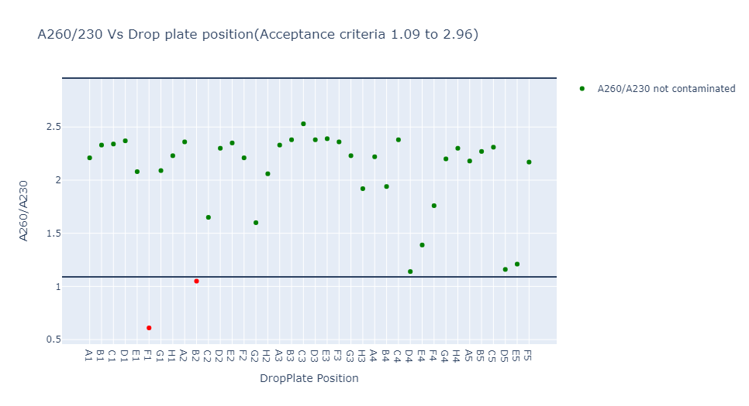
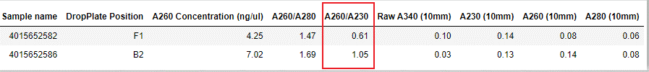
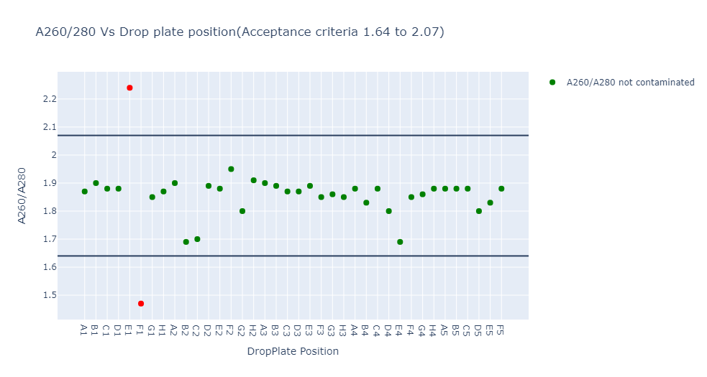

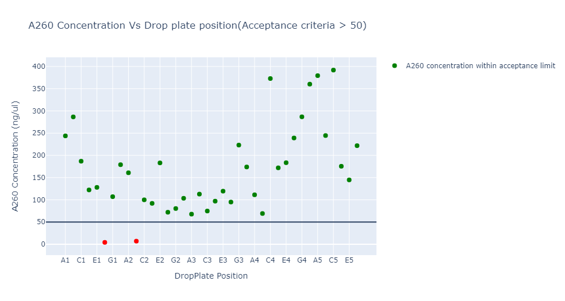

Project : Our Future Health (OFH)
Period | Feb'22
Number of Samples | 38
Type | Mean | -2 SD | + 2 SD | Remarks
A260/230 | 2.03 | 1.09 | 2.96
A260/280 | 1.85 | 1.64 | 2.07
A260 Concentration | >= 50 ng/ml |  |  | Defined by the client
Conclusion:
Less number of samples
The acceptance criteria for A260/280 & A260/230. Hence performed the analysis with +/- 2 SD.
The values in A340 is not good for analysis with SD. This will be done in the next iteration when the acceptance criteria is defined.
The samples that are having less purity : 4015652582, 4015652582 and 4015652581.

Slide 2

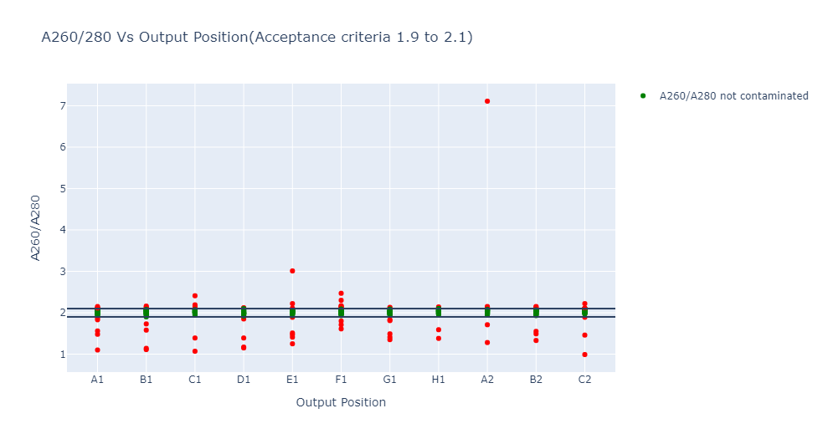
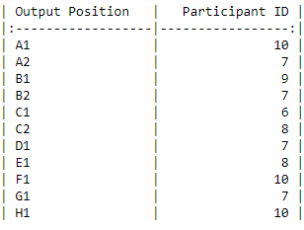
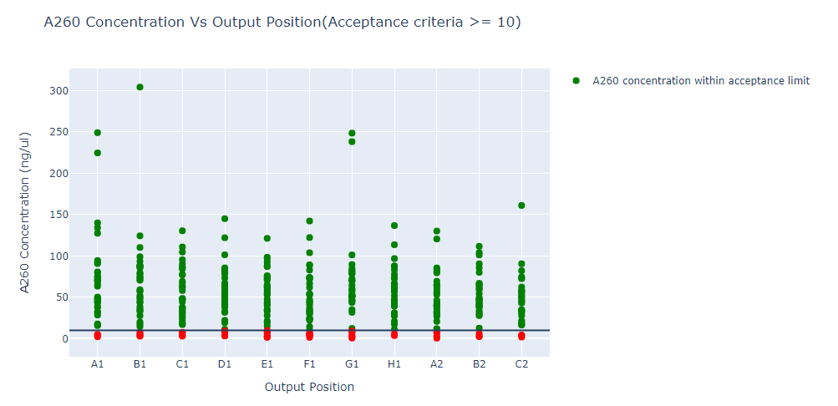
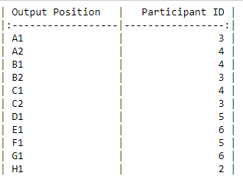
Project : GEL RNA
Period | Apr'2022
No. of samples | 384
Type | Min | Max | Remarks
A260/230 |  |  | Not defined
A260/280 | 1.9 | 2.1 | Defined by the client
A260 Concentration | >=10 ng/ml
A260/280 Analysis
89 samples are out of acceptance criteria
Each plate has minimum contamination of 6
A260 Concentration
45 samples are out of acceptance criteria
Min Contamination = 2 (H1)
Max Contamination = 6 (E1)

